Slide 1
KEB-45250 Numerical Techniques for Process Modeling
Spring 2018
Antti Mikkonen
Kaj Lampio
Niko Niemelä

Slide 2
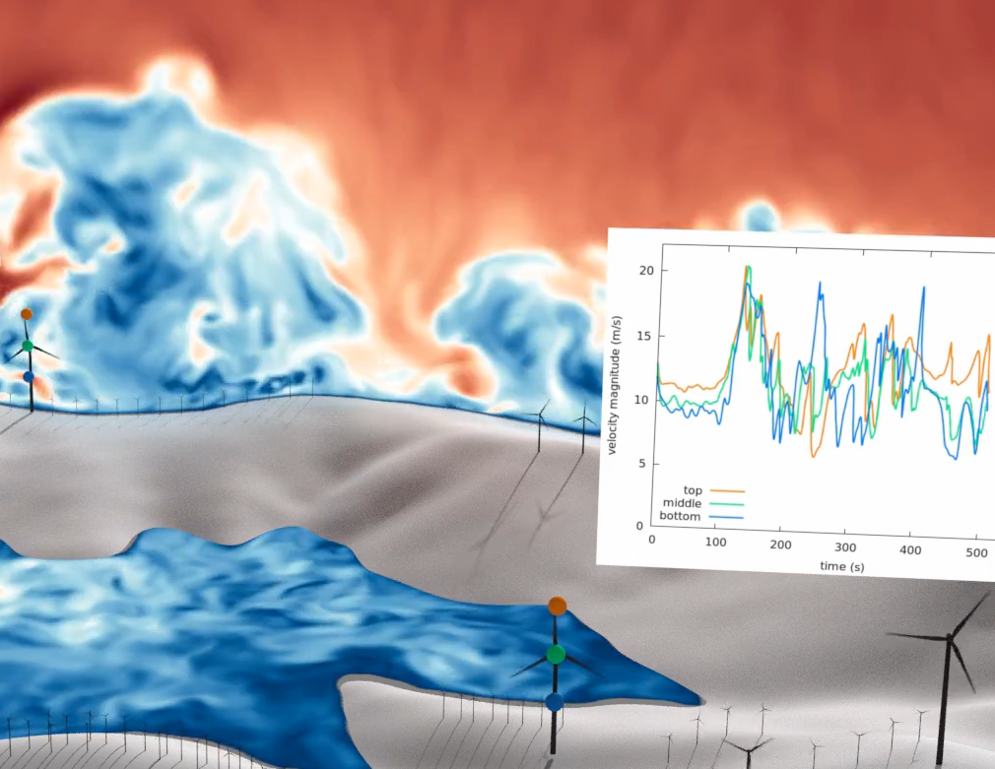

What is the course about?
Industrial applications
Heat transfer
Fluid flow
Reacting systems
Numerical modeling
Flexible
Custom codes
Software packages

Slide 3
General information
First implementation, all plans are tentative
Lectures
Wednesday 13-15 K1241
Exercises
Thursday 10-12 SB202 – Computer lab
Intensive course on ANSYS Fluent
Tuesday 30.1. 9-16 SB202
Wednesday 31.1. 9-15 RG100C

Slide 4
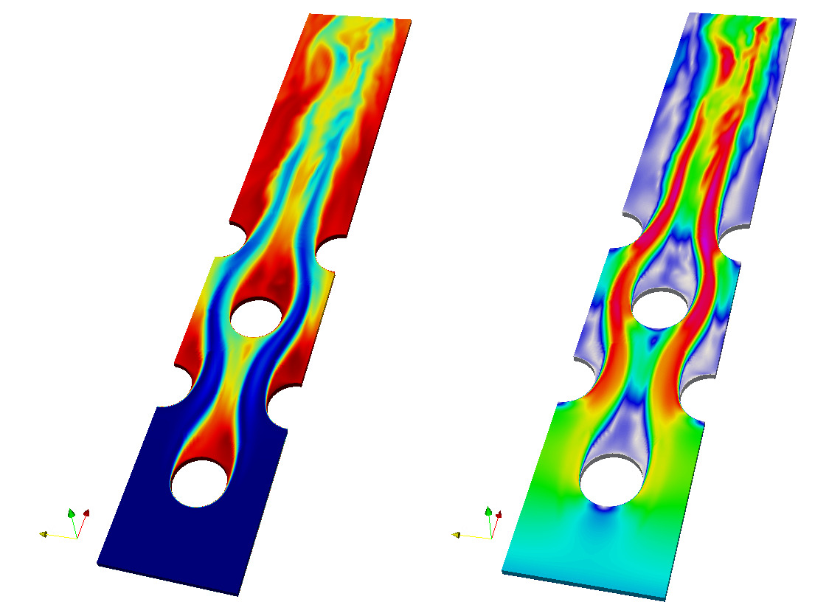
CFD software
ANSYS Fluent
Computational Fluid Dynamics (CFD) software on this course
Easy to learn
Commercial and expensive
Intensive course
Tuesday 30.1 9-16 SB202
Wednesday 31.1. 9-15 RG100C
OpenFOAM
More popular at TUT
Slow to learn
Free and open source

Slide 5
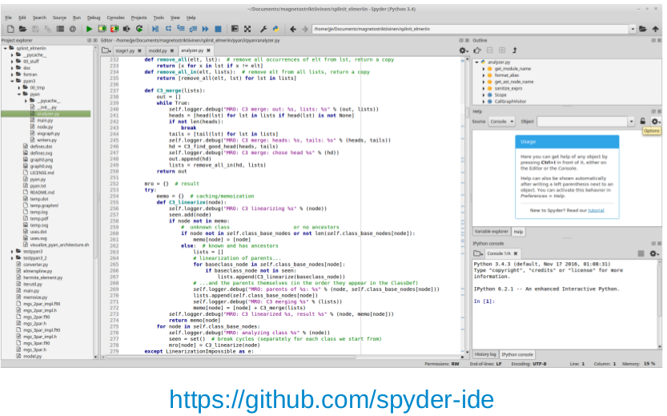
Programming language
Python 3.6
Most familiar with
One of the most popular languages in the world
Extensive liberties for engineer
If you want to use something else, for example Matlab, just ask

Slide 6
Mandatory steps to pass
Exam
60% of total points
Must be passed
2 assignments with reports
40% of total points
Must be passed

Slide 7
Exam, 60%
11.05.2018, time: 17-20
Preliminary plan
5 questions
2.5 about Computational Fluid Dynamics
1.5 about numerical modeling in general
1 about reacting systems

Slide 8

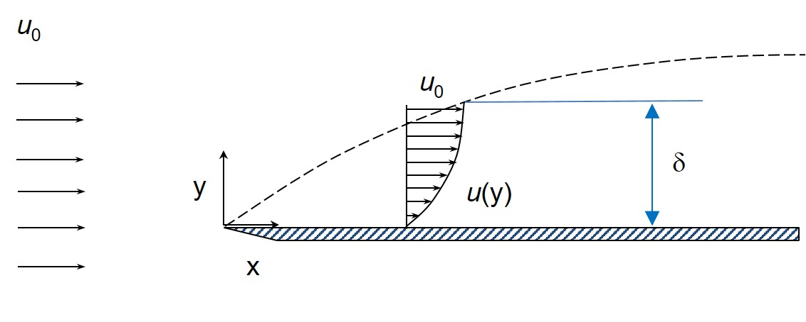
Assignment 1, 25%
Two options
Calculate a 2D case with CFD software
Probably wing
Ansys Fluent/OpenFOAM
Industry oriented
Own code
Probably flat plate
Python/other language
Deeper understanding
You can also do both
5-10% extra

Slide 9
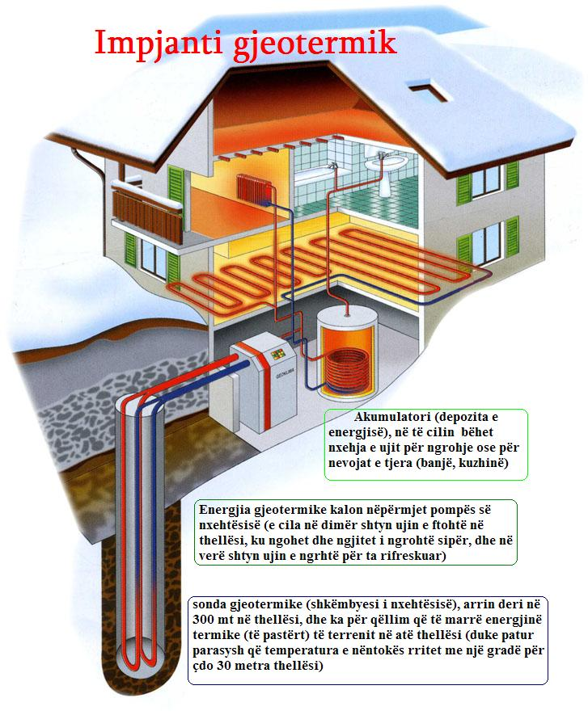
Assignment 2, 15%
Custom code (Python)
Custom code is better for some applications
Maybe geothermal energy
https://commons.wikimedia.org/wiki/File:Impjanti_Gjeotermik.jpg

Slide 10
Course material
CFD
There will be lecture notes
Additionally:
H. Versteeg & W. Malalasekera:
"An introduction to computational fluid dynamics: The finite-volume method", 2nd ed.
Lecture slides for the rest

Slide 11
Tentative plan
 |  |  | Lectures |  | Exercises
Month | Week | Day |  | Day
1 | 1 | 3 |  | 4
 | 2 | 10 | Introduction | 11 | Python basics and libraries
 | 3 | 17 | Basics. Matrix, NS,… | 18 | Lecture material
 | 4 | 24 | CFD Basics | 25 | Lecture material
2 | 5 | 30 | ANSYS intensive course | 31 | ANSYS intensive course
 | 6 | 7 | Heat convection, FVM | 8 | Lecture material with Python
 | 7 | 14 | Advection | 15 | Lecture material with Python
 | 8 | 21 | Navier-Stokes | 22 | Navier-Stokes with ANSYS
 | 9 | 28 | Mesh | 1 | Mesh with ANSYS
3 | 10 | 7 | Turbulence | 8 | Turbulence with ANSYS
 | 11 | 14 | Linear systems | 15 | Lecture material
 | 12 | 21 | Linear systems | 22 | Lecture material
 | 13 | 28 | Easter Holiday | 29 | Easter Holiday
4 | 14 | 4 | Non-linear systems | 5 | Lecture material
 | 15 | 11 | Non-linear systems | 12 | Lecture material
 | 16 | 18 | Reacting systems | 19 | Lecture material
 | 17 | 25 | Reacting systems | 26 | Lecture material

Slide 12
Example Cases
Glass tempering
Antti Mikkonen
Fin optimization (separate slides)
Kaj Lampio
Combustion modelling (separate slides)
Niko Niemelä

Slide 13
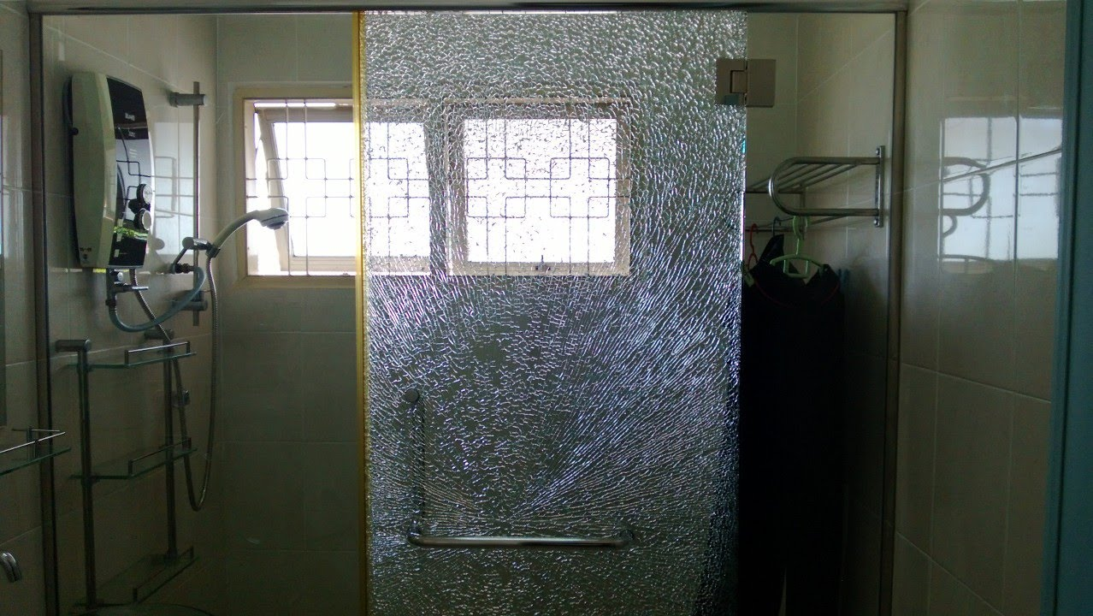
Tempered Glass
Safety Glass Door
by Wei Min Chan,
https://www.youtube.com/watch?v=aQ902DfWILs
John Hancock Panorama, Chicago
by RhythmicQuietude, CC BY-SA 3.0 https://commons.wikimedia.org/w/index.php?curid=10589310

Slide 14
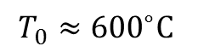
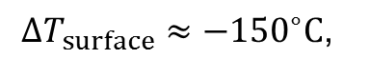
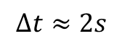
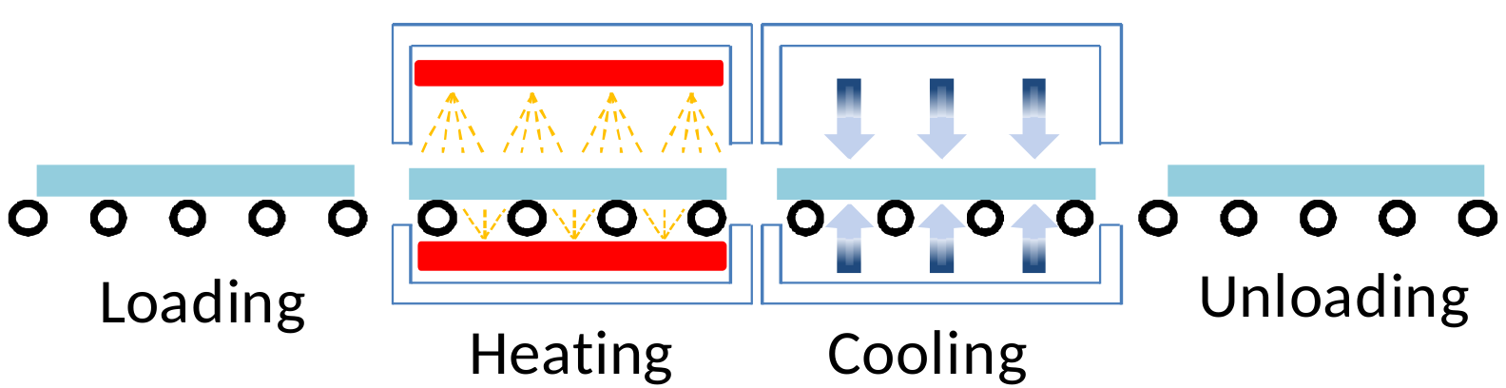
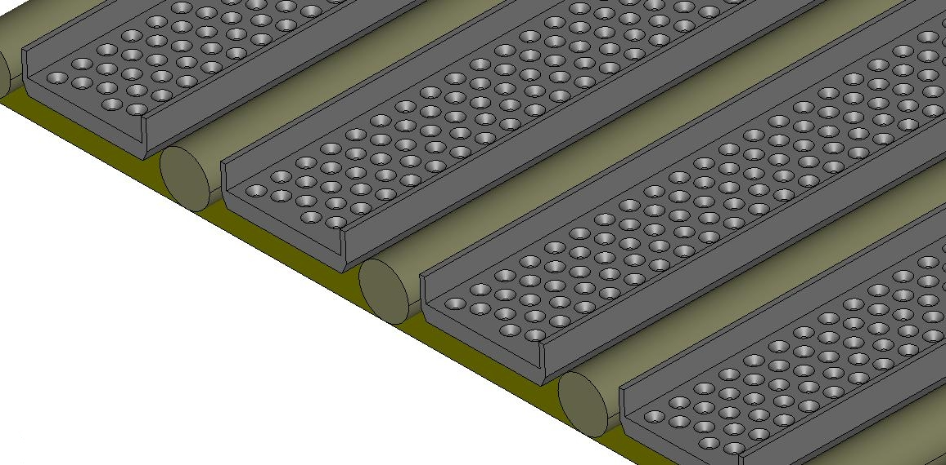
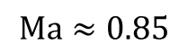
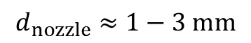
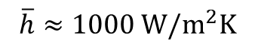
Production
Aronen 2012 [1]
Cooling Jets

Slide 15
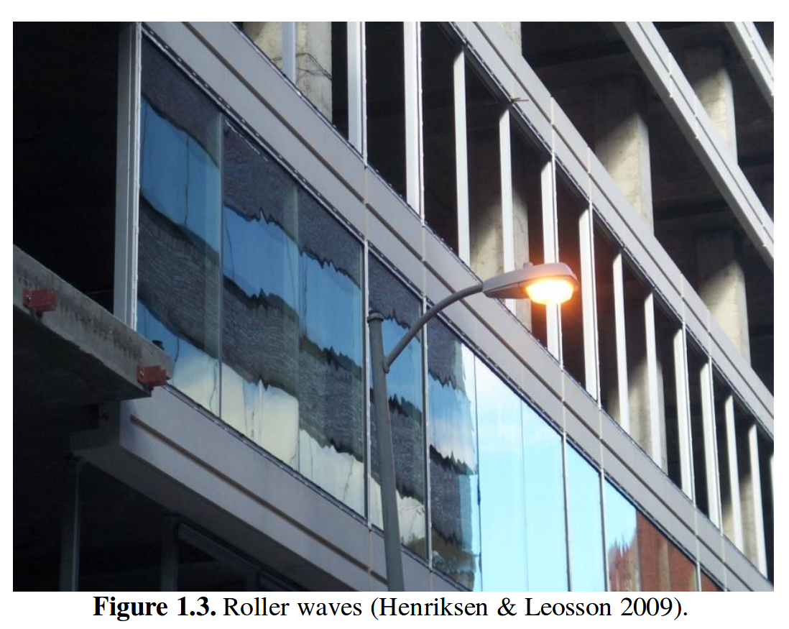
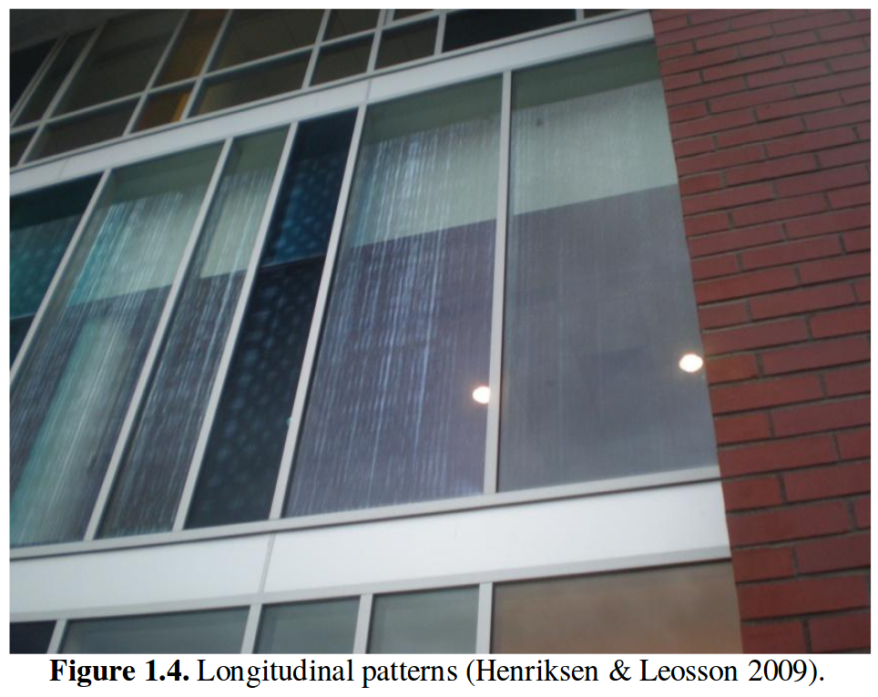
Visual issues

Slide 16
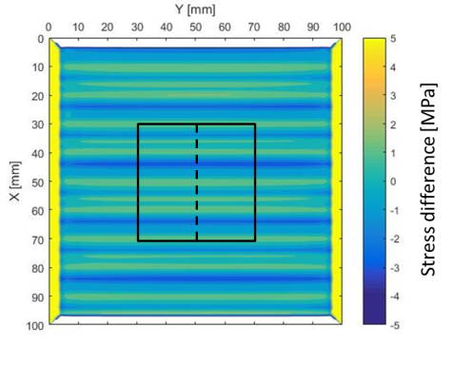
Residual stress

Slide 17
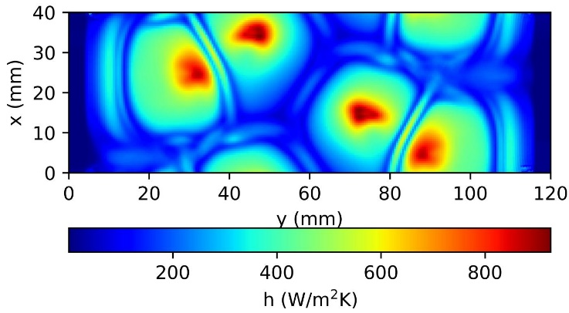
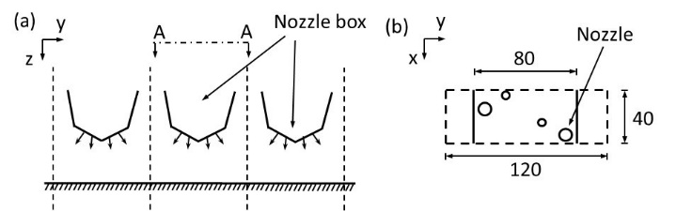
Heat transfer modeling
Schematic of the nozzles (a) and locations in nozzle plate (b).
Distribution of heat transfer coefficient

Slide 18
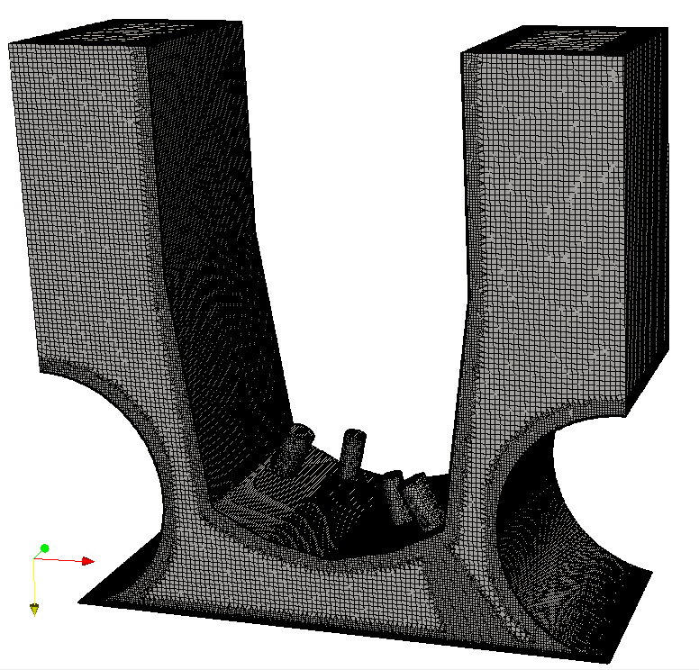
Mesh

Slide 19
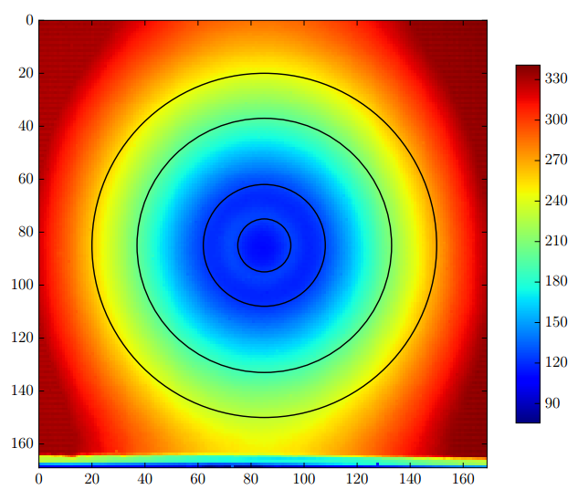
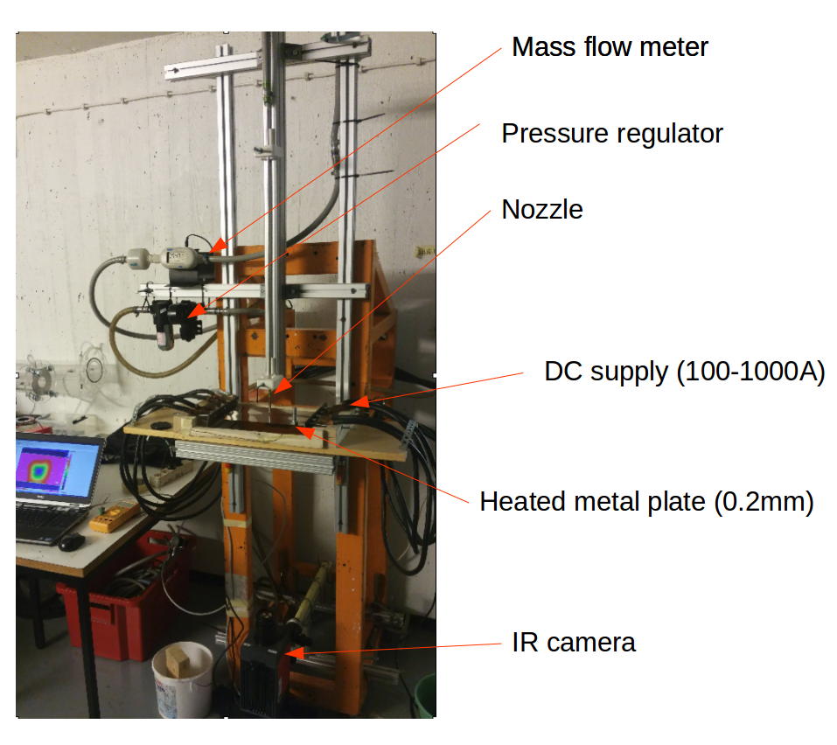
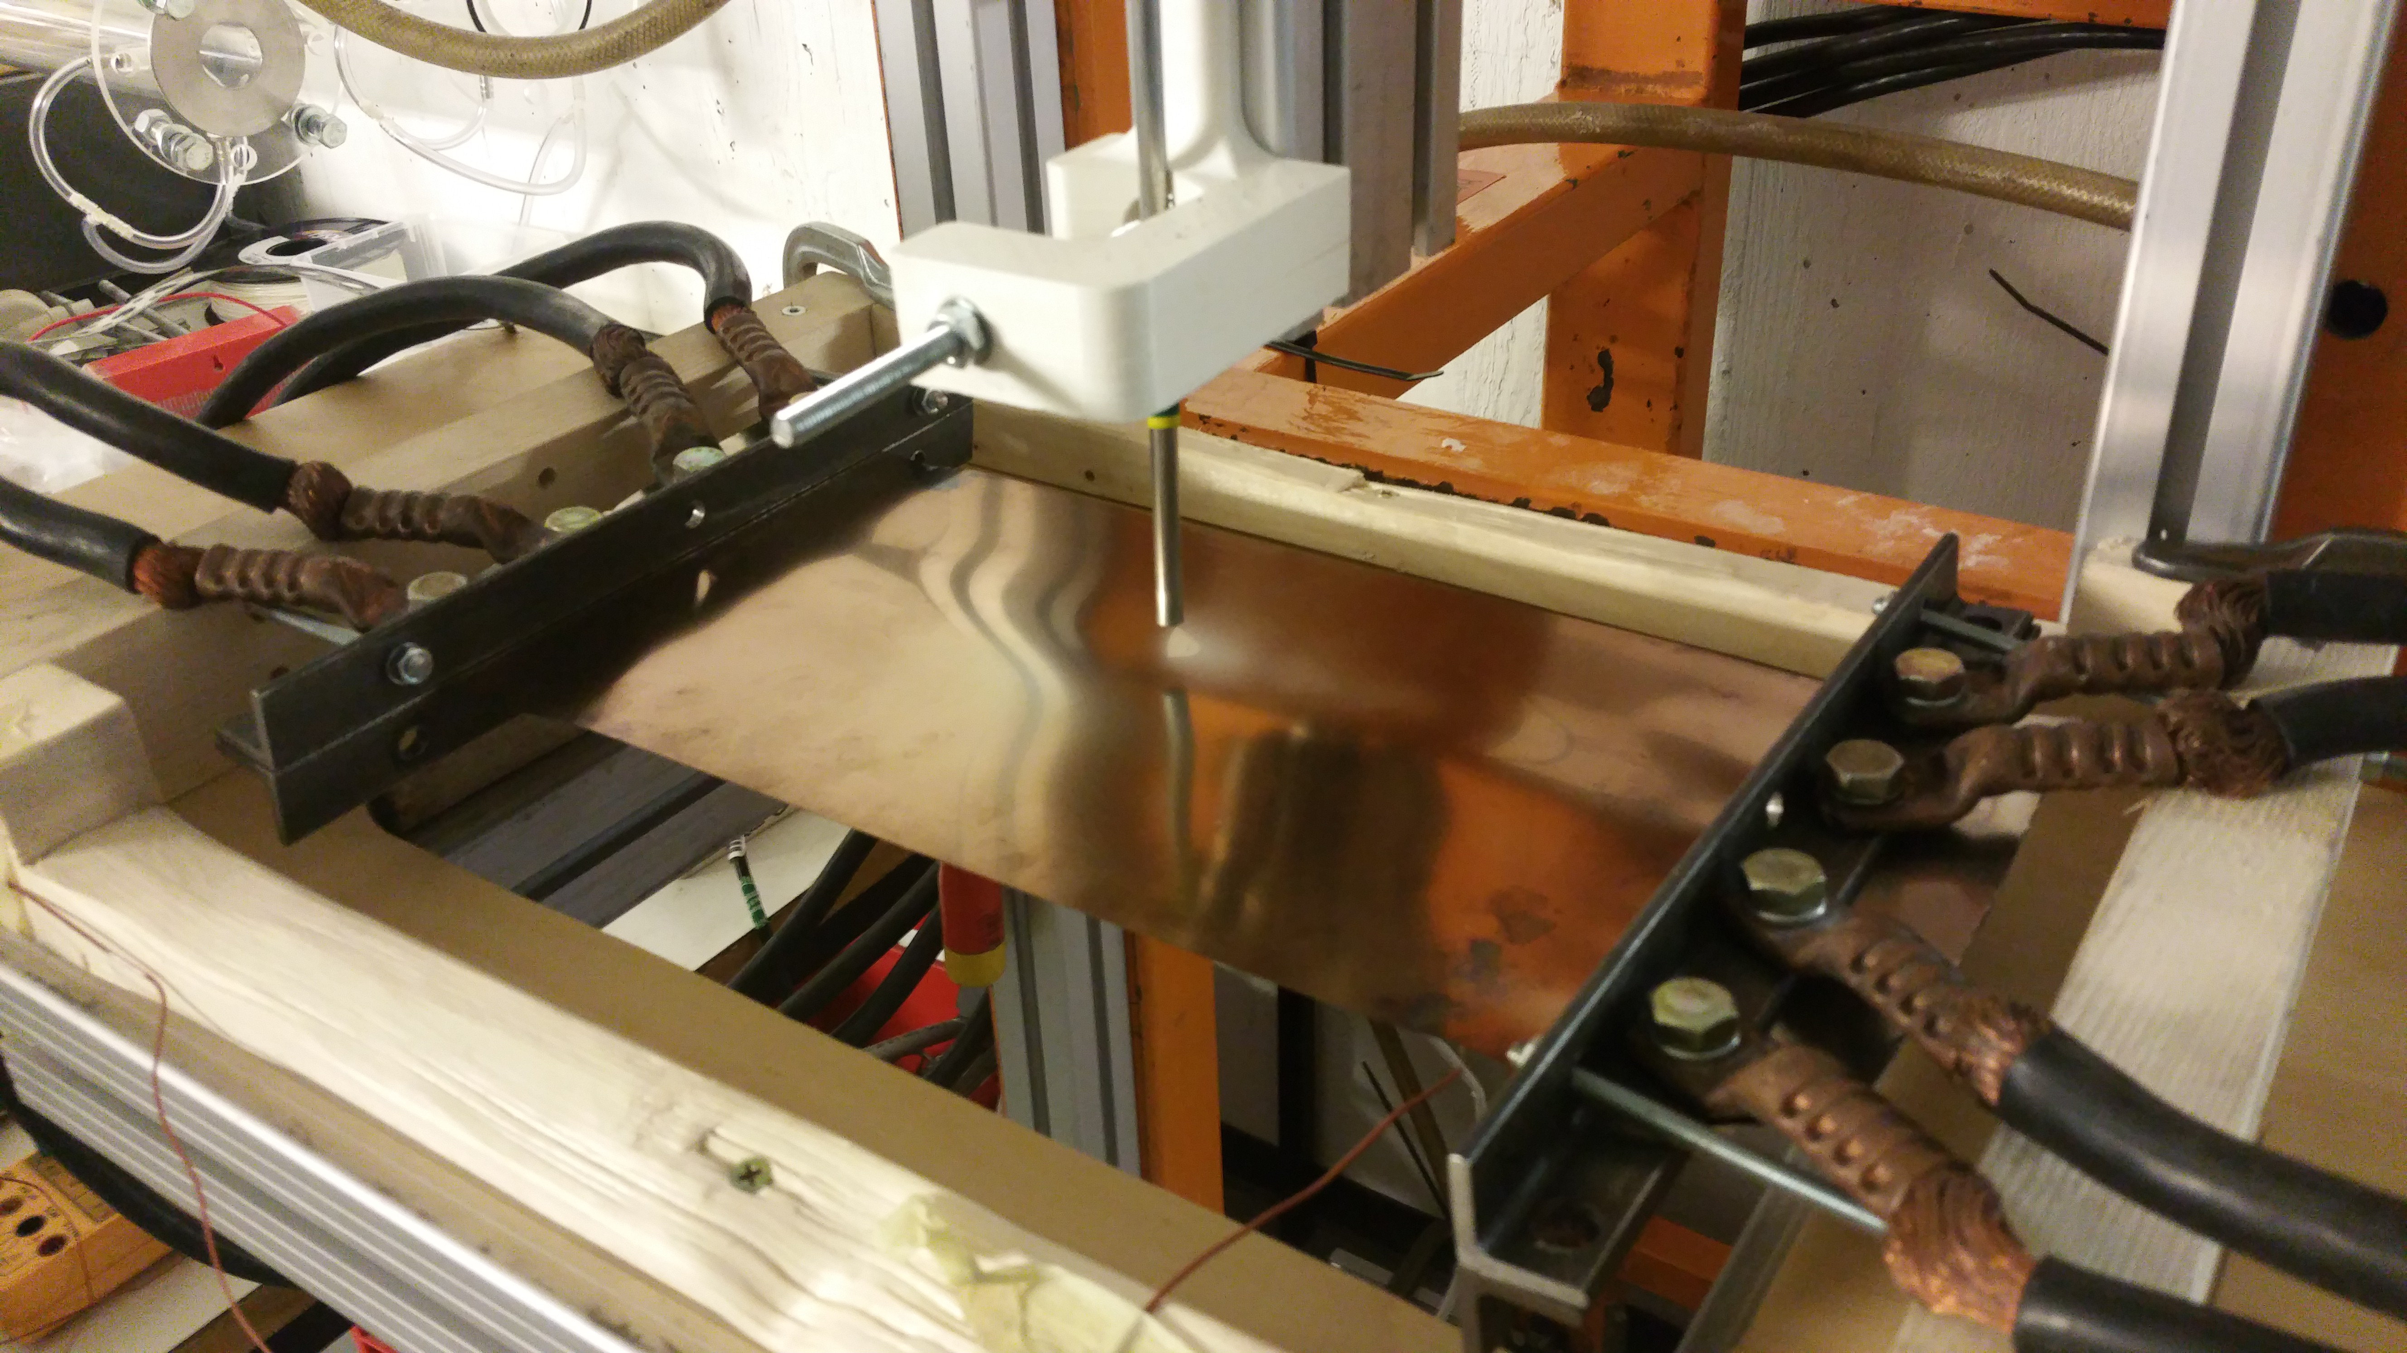
Measurements

Slide 20
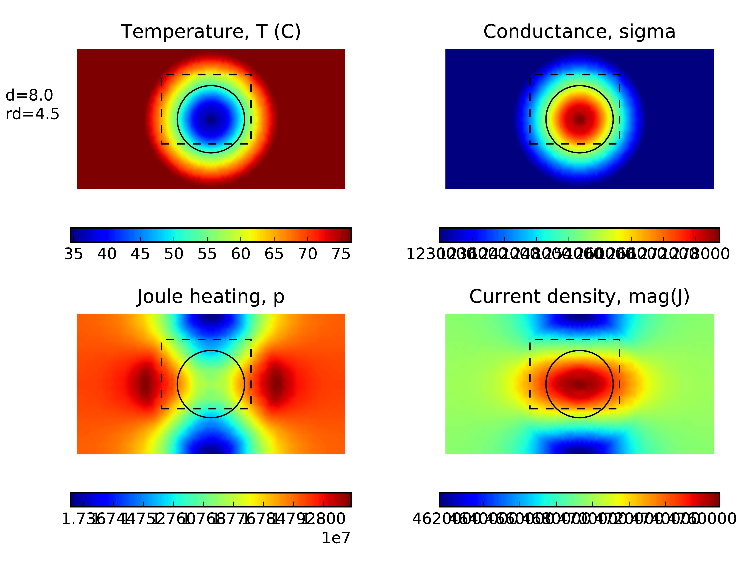
Joule heating

Slide 21
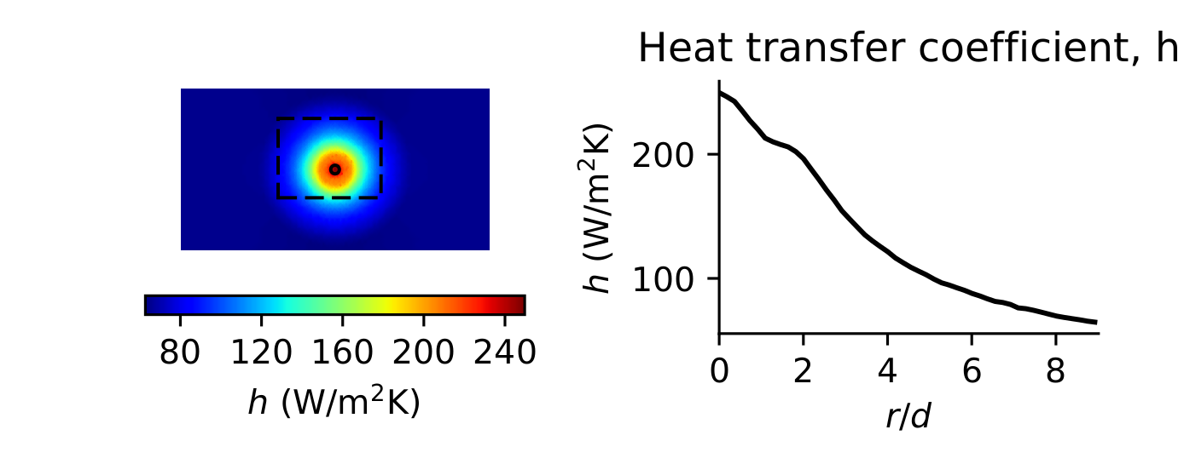
Heat transfer

Slide 22

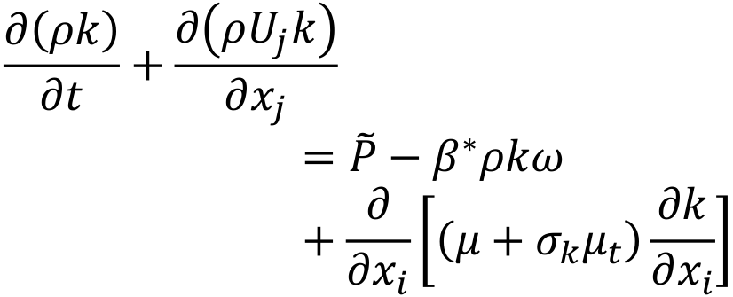
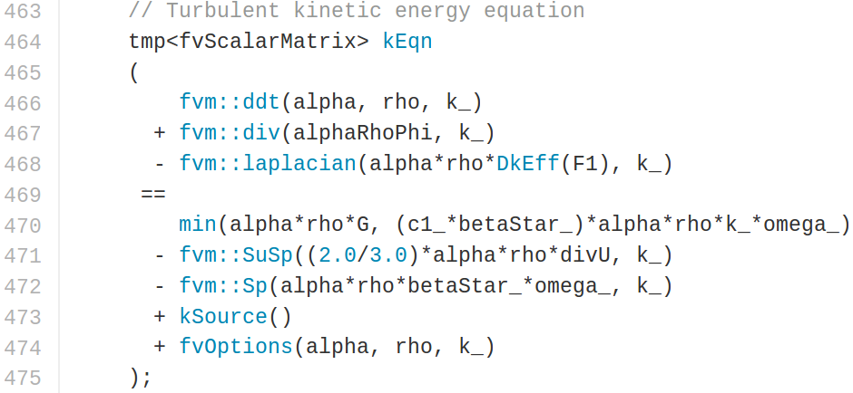
OpenFOAM, Open Source
Full address:
https://github.com/OpenFOAM/OpenFOAM-dev/blob/master/src/TurbulenceModels/turbulenceModels/RAS/kOmegaSST/kOmegaSST.C
Antti Mikkonen, ICCHMT 2016, Cracow
23-26 May6
22/17

Slide 23
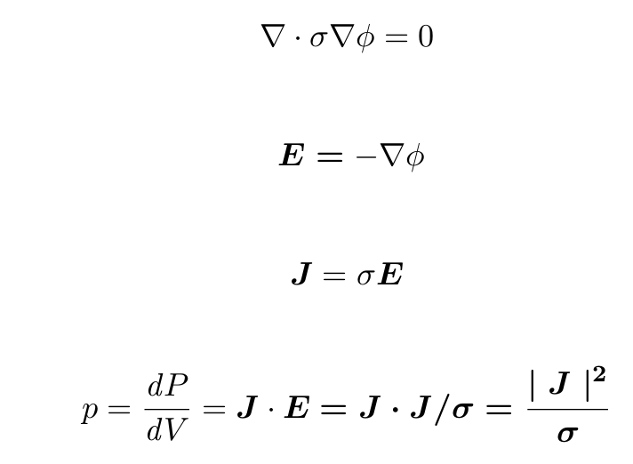
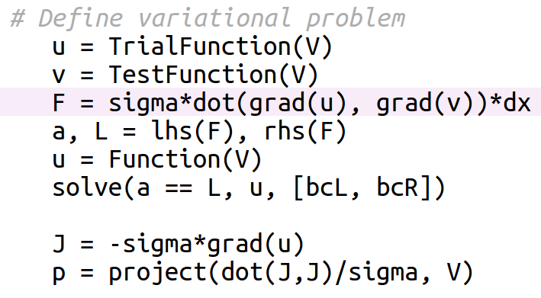
Electric heating

